Slide 1

Geometry
Unit 5, Lesson 5 Drawing Conclusions from Given Information Volume 1, pg. 246

Slide 2


Benchmarks
MA.912.GR.1.2
Prove triangle congruence or similarity using Side-Side-Side, Side-Angle-Side, Angle-Side-Angle, Angle-Angle-Side, Angle-Angle, and Hypotenuse-Leg.
MA.912.LT.4.10
Judge the validity of arguments and give counterexamples to disprove statements.
volume 1, pg. 246

Slide 3
Integrated Mathematical Thinking and Reasoning Standards
MA.K12.MTR.2.1 Demonstrate understanding by representing problems in multiple ways.
MA.K12.MTR.4.1 Engage in discussions that reflect on the mathematical thinking of self and others.
MA.K12.MTR.5.1 Use patterns and structure to help understand and connect mathematical concepts.
volume 1, pg. 246

Slide 4

Learning Targets
I can draw and mark figures using given information.
I can use definitions, properties, postulates, and theorems to draw conclusions about triangles from given information.
volume 1, pg. 246

Slide 5

Warm-Up
volume 1, pg. 247

Slide 6
5.5.1 Warm-Up: Working Through Challenges
Teri takes dance in school, but learning how to tap dance was a new and overwhelming experience. She said that after her teacher introduced tap, “It was really hard for me to learn … It just looked like a lot of work and looked like it took a lot of time to learn, and it was really high tempo.”
What is something that felt overwhelming the first time you were learning it?
volume 1, pg. 247

Slide 7
Teri’s teacher slowed down the moves to show her the structure and recommended that she practice each step before trying to put it all together. She connected this experience to learning other things that are difficult, saying, “The more you practice a certain skill that you need, the better you become at it, and the easier it becomes.”
Describe a time when practicing something that was challenging for you helped you become better at it.
volume 1, pg. 247

Slide 8

Collaboration
volume 1, pg. 247

Slide 9

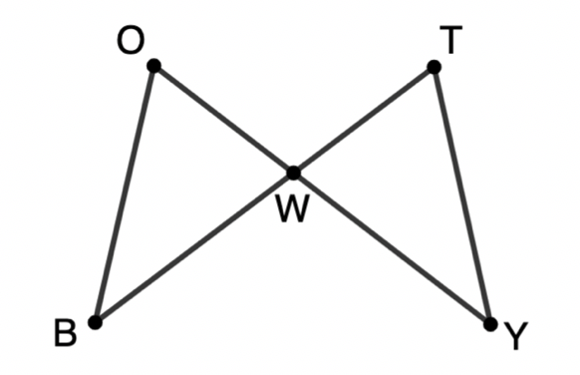
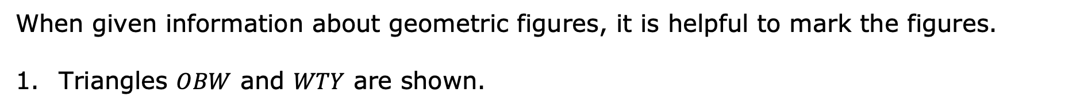
5.5.2 Collaboration: Using Given Information to Mark Figures
When given information about geometric figures, it is helpful to mark the figures.
Triangles $OBW$ and $WTY$ are shown.
volume 1, pg. 247

Slide 10
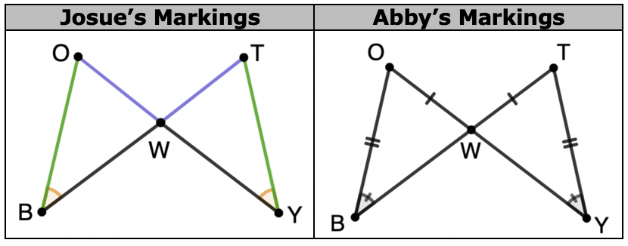

Josue and Abby marked the figure in different ways given $\overline{OW}≅\overline{TW}$, $\overline{OB}≅\overline{TY}$, and $∠OBW≅∠TYW$ as shown.
Discuss with your partner what you notice about how Josue and Abby each marked the figure.
volume 1, pg. 247

Slide 11
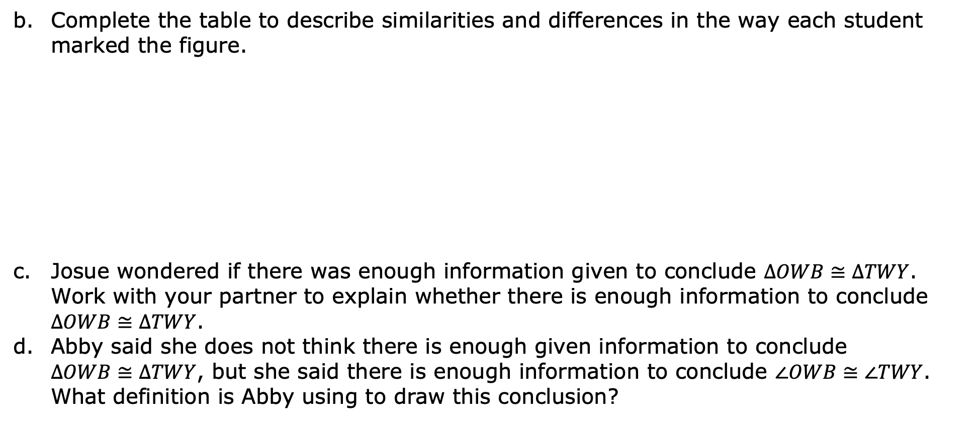
Complete the table to describe similarities and differences in the way each student marked the figure.
Josue wondered if there was enough information given to conclude $∆OWB≅∆TWY$. Work with your partner to explain whether there is enough information to conclude $∆OWB≅∆TWY$.
Abby said she does not think there is enough given information to conclude $∆OWB≅∆TWY$, but she said there is enough information to conclude $∠OWB≅∠TWY$. What definition is Abby using to draw this conclusion?
How were their markings similar? | How were their markings different?
volume 1, pg. 248

Slide 12
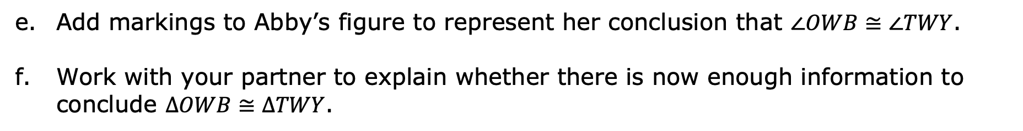
Add markings to Abby’s figure to represent her conclusion that $∠OWB≅∠TWY$.
Work with your partner to explain whether there is now enough information to conclude $∆OWB≅∆TWY$.
volume 1, pg. 248

Slide 13
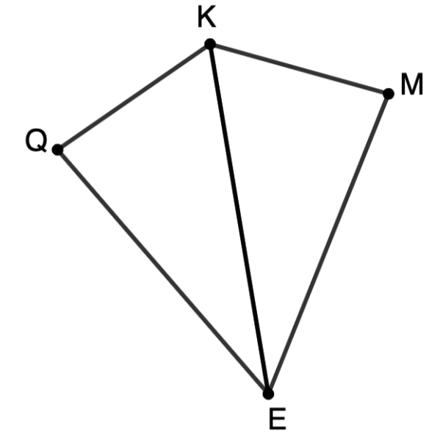

Mark polygon KQEM using the given information. $\overline{EQ}≅\overline{EM}$ and $∠KEQ≅∠KEM$
Compare your markings with your partner. Make any corrections if necessary.
volume 1, pg. 248

Slide 14

Guided Instruction
volume 1, pg. 249

Slide 15
5.5.3 Guided Instruction: Drawing Conclusions From Given Information
Given information, definitions, properties, postulates, and theorems can be used to draw conclusions about figures.
What are some definitions, properties, postulates, and theorems related to triangles and angles learned so far this year?
Definitions
Properties
Theorems and Postulates
volume 1, pg. 249

Slide 16

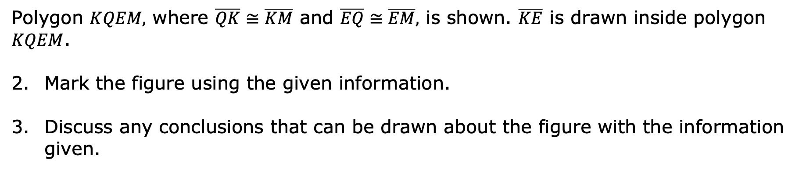
Polygon $KQEM,$ where $\overline{QK}≅\overline{KM}$ and $\overline{EQ}≅\overline{EM},$ is shown. $\overline{KE}$ is drawn inside polygon $KQEM$.
Mark the figure using the given information.
Discuss any conclusions that can be drawn about the figure with the information given.
volume 1, pg. 249

Slide 17
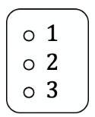
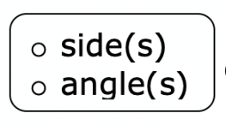
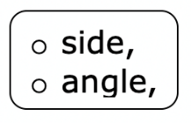
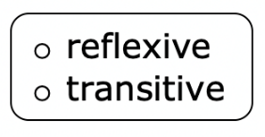
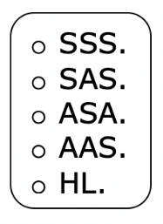
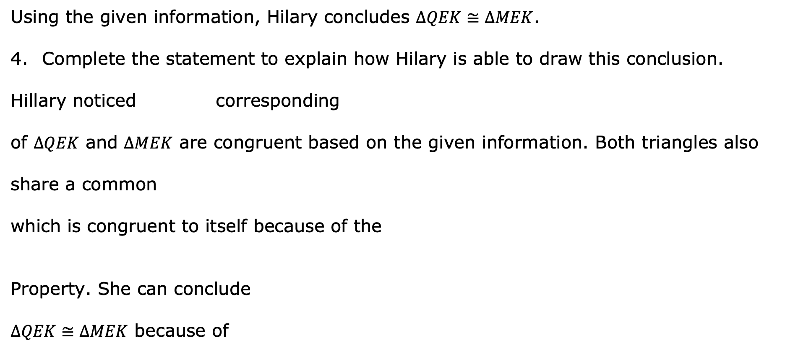
Using the given information, Hilary concludes $∆QEK≅∆MEK$.
Complete the statement to explain how Hilary is able to draw this conclusion.
Hillary noticed corresponding
of $∆QEK$ and $∆MEK$ are congruent based on the given information. Both triangles also
share a common
which is congruent to itself because of the
Property. She can conclude
$∆QEK≅∆MEK$ because of
volume 1, pg. 249

Slide 18
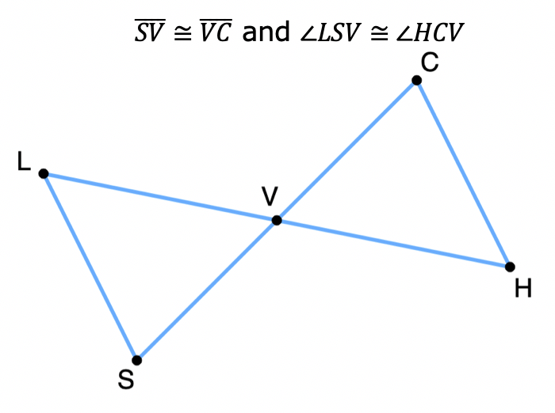
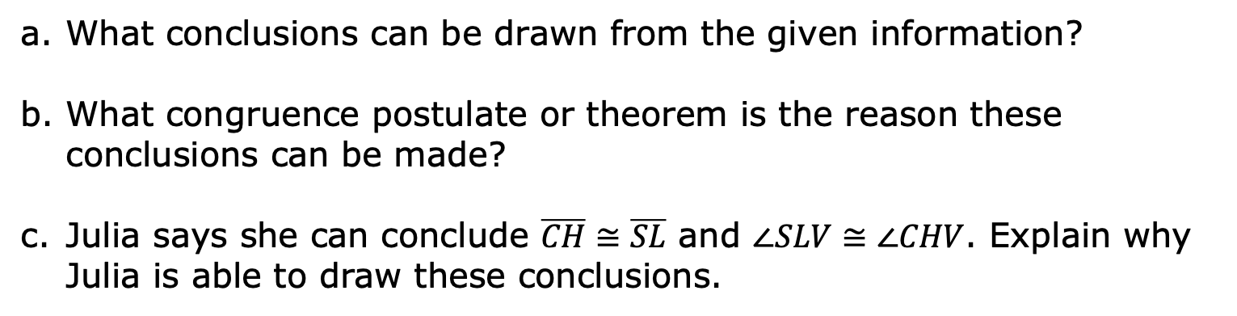
Triangle $LVS$ and triangle $CVH$ are shown.
What conclusions can be drawn from the given information?
What congruence postulate or theorem is the reason these conclusions can be made?
Julia says she can conclude $\overline{CH}≅\overline{SL}$ and $∠SLV≅∠CHV$. Explain why Julia is able to draw these conclusions.
volume 1, pg. 250

Slide 19
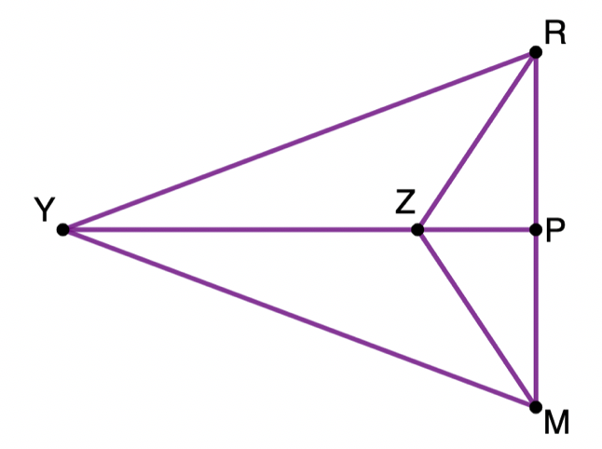
Triangle $RMY$ is shown. $∠YMZ≅∠YRZ$ and $∠RZY≅∠MZY$.
Work with your partner to complete the statements based on the given information.
I can conclude …
I know this because …
volume 1, pg. 250

Slide 20
Collaboration
volume 1, pg. 251

Slide 21
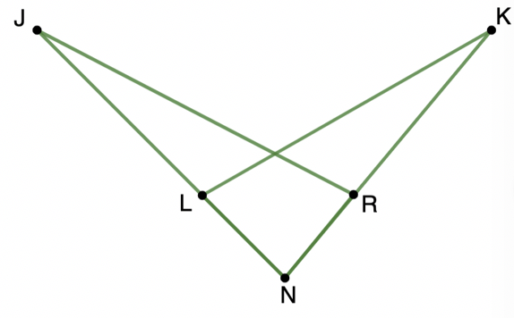
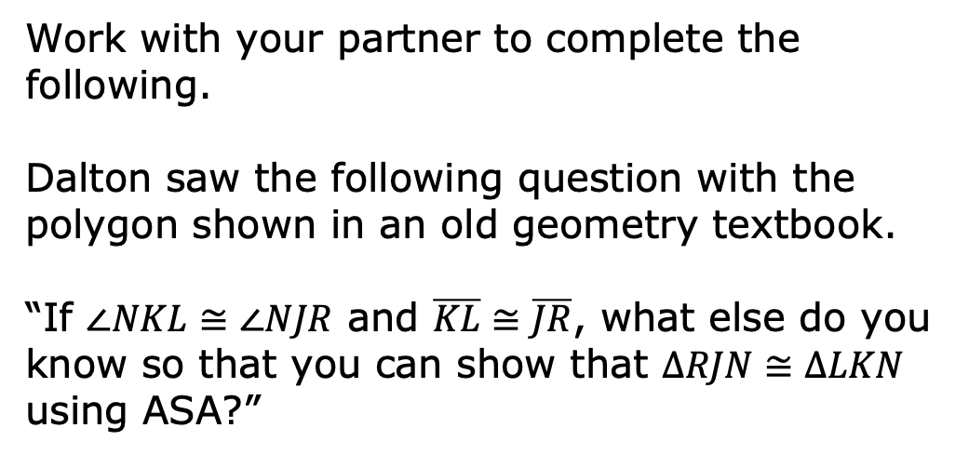
5.5.4 Collaboration: Overlapping Triangles
Work with your partner to complete the following.
Dalton saw the following question with the polygon shown in an old geometry textbook.
“If $∠NKL≅∠NJR$ and $\overline{KL}≅\overline{JR}$, what else do you know so that you can show that $∆RJN≅∆LKN$ using ASA?”
volume 1, pg. 251

Slide 22
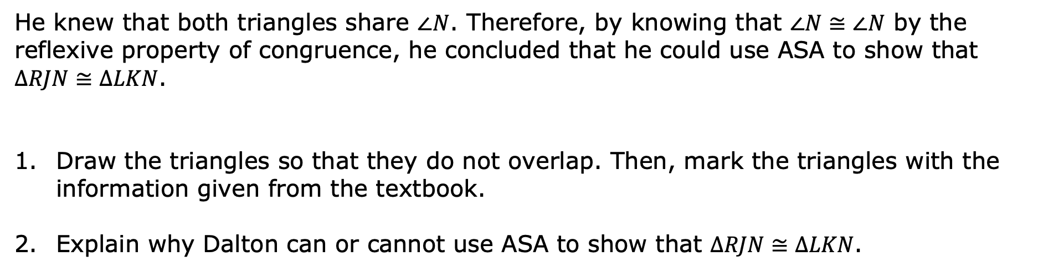
He knew that both triangles share $∠N$. Therefore, by knowing that $∠N≅∠N$ by the reflexive property of congruence, he concluded that he could use ASA to show that $∆RJN≅∆LKN$.
Draw the triangles so that they do not overlap. Then, mark the triangles with the information given from the textbook.
Explain why Dalton can or cannot use ASA to show that $∆RJN≅∆LKN$.
volume 1, pg. 251

Slide 23

Try It
volume 1, pg. 251

Slide 24

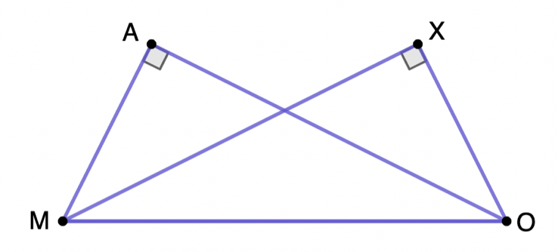

5.5.5 Try It: Drawing Conclusions From Given Information
Triangle $MAO$ and triangle $XOM$ are shown, where $∠MAO$ and $∠OXM$ are right angles and $\overline{MA}≅\overline{XO}$.
Complete each statement based on the given information.
I can conclude that …
I know this because …
volume 1, pg. 251

Slide 25

Wrap-Up
volume 1, pg. 252

Slide 26
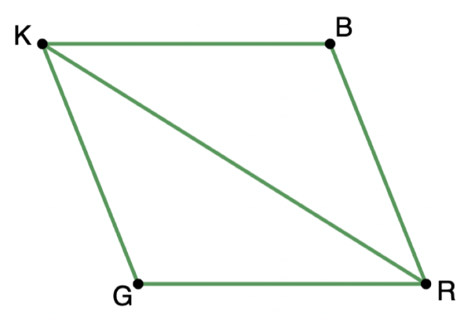
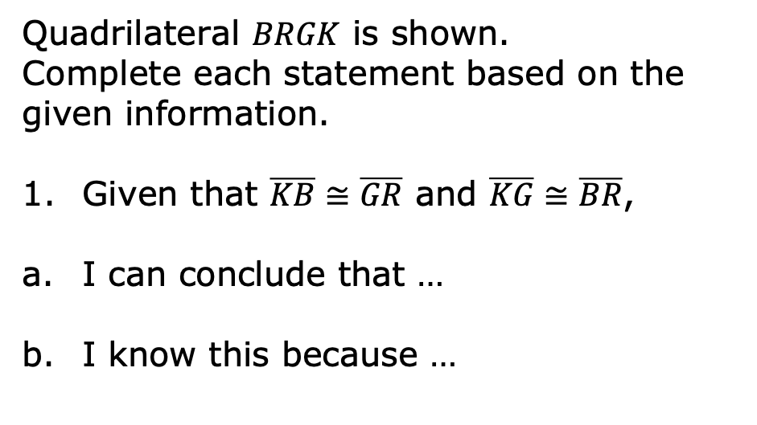
5.5.6 Wrap-Up: Ticket Out the Door
Quadrilateral $BRGK$ is shown.
Complete each statement based on the given information.
Given that $\overline{KB}≅\overline{GR}$ and $\overline{KG}≅\overline{BR}$,
I can conclude that …
I know this because …
volume 1, pg. 252

Slide 27

Given that $\overline{KB}≅\overline{KG}$ and $\overline{RG}≅\overline{BR}$,
I can conclude that …
I know this because …
Given that $\overline{KG}∥\overline{BR}$ and $\overline{KB}∥\overline{GR}$,
I can conclude that …
I know this because …
volume 1, pg. 252

